Slide 1

“Anytime, Anywhere Learning”

Slide 2
Our solution
A platform to match tutors and students.
We use geo location.
Cross platform mobile app.
Our own matching algorithm.

Slide 3
Some other features
Tag based indexing.
Include personal publications.
Dynamic skill ratings for tutors.
Student feedback.
Integration with Google and Facebook.

Slide 4
Idea viability
Easy to market due to cross platform support.
Large user base in 3 mobile platforms.
Android
Apple
Windows
Low cost of implementation

Slide 6
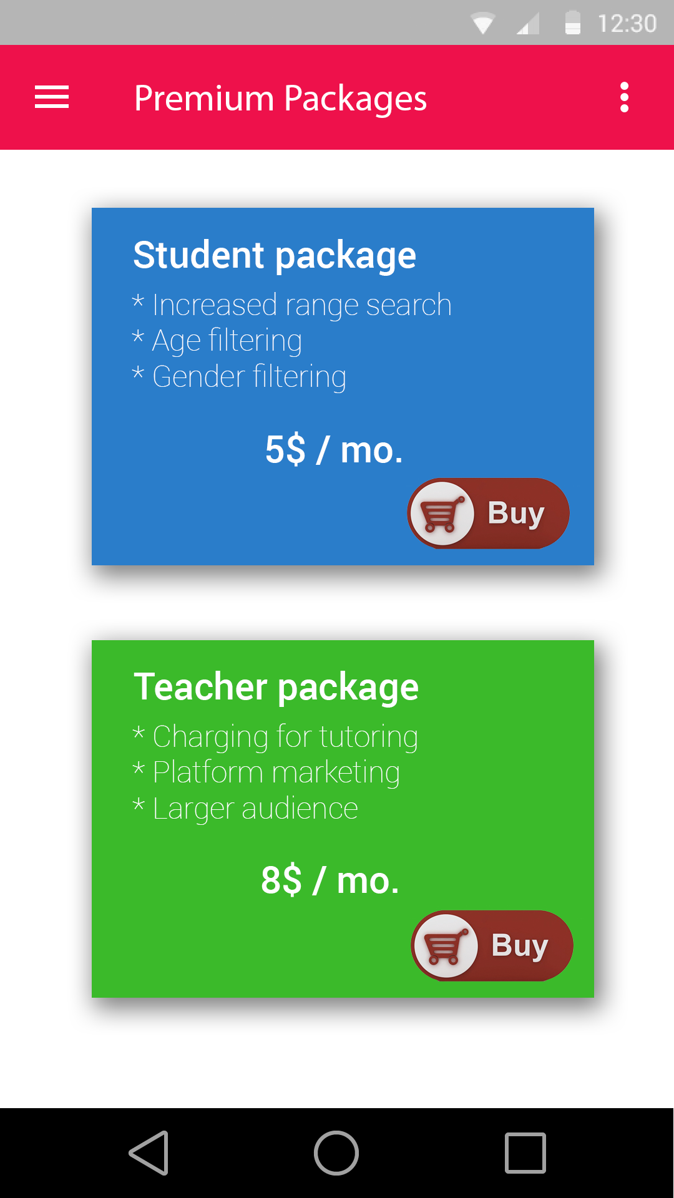
Two types of Premium Packages

Slide 7
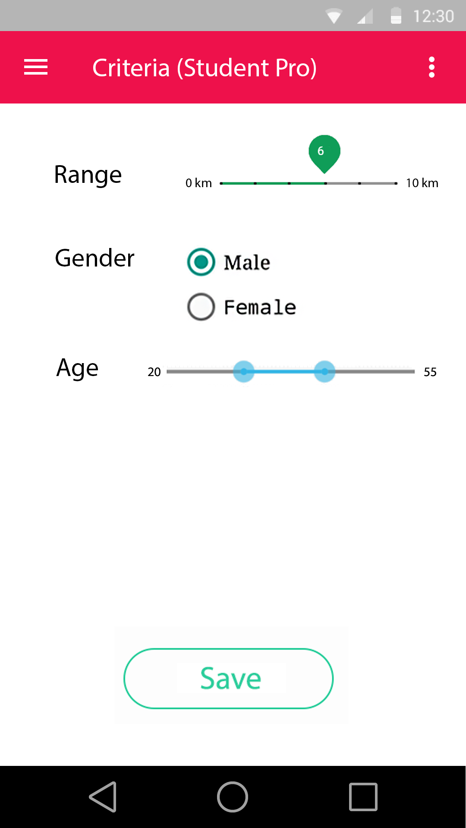
Features given for the Student Pro Users

Slide 8
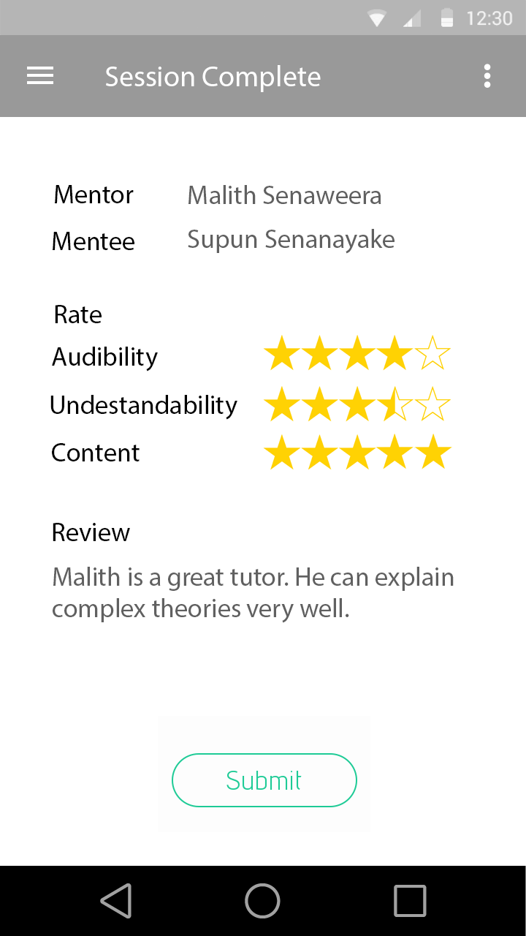
After a session student
can feedback the tutor

